Slide 1
Travel Insurance
Efficient advertising
Pedro Fernandes
1/12/2021

Slide 2

Data
1987 rows
Representing customers and non-customers that got quotes
Description across 9 categories including if they are a customer or not
All represented had an interaction with us
quotes : estimated cost provided by the insurance company for an insurance policy.
= Churn rate
Initial Churn rate = 35%

Slide 3
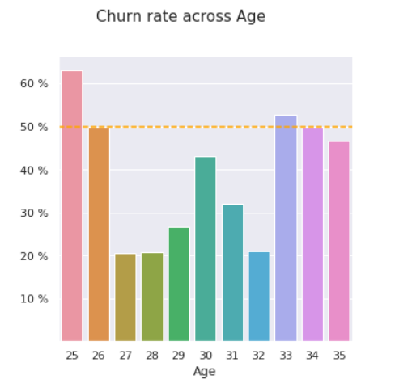
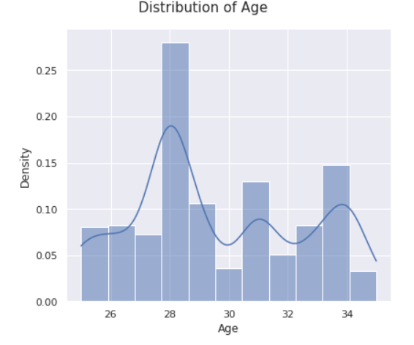
Age
Ages : <26, 30 , 33<
Improve churn : 35%
52 % (+17%)
95% CI = [ 48% - 55% ]

Slide 4
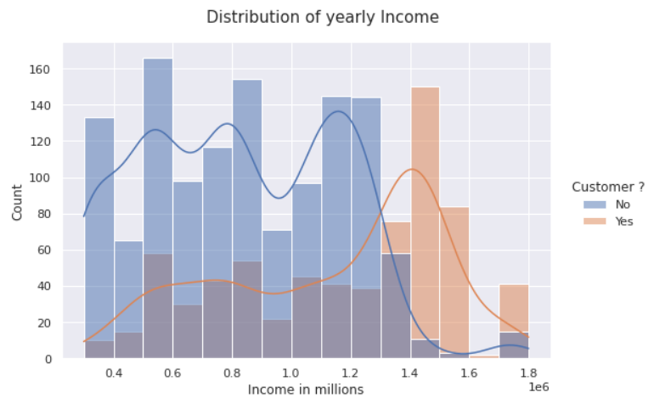
Annual Income
Churn rate is higher when income is bigger than 1.3 millions a year.
Improve churn : 35%
91 % (+ 56% )
95 % CI = [ 88% - 94% ]
Represents : 17%
> 500k /year
Bigger the better

Slide 5
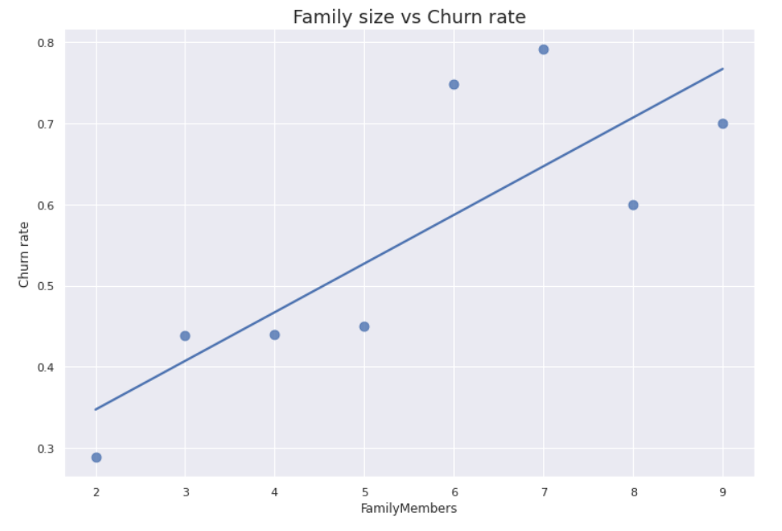
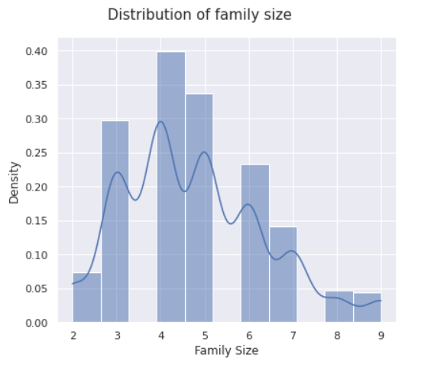
Family Size
Higher = better
Improve churn : 35%
43% (+ 8%)
95 % CI =[ 39% - 47% ]
80 % 3-6

Slide 6
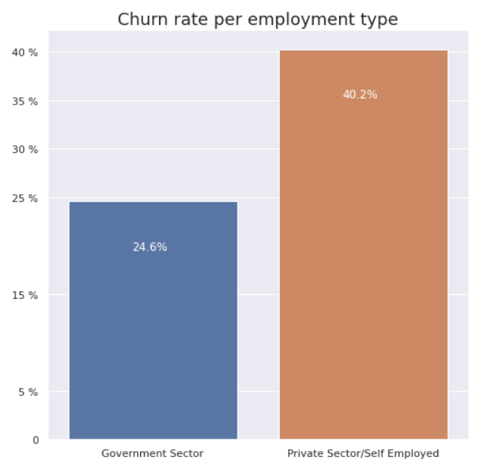
More factors that improve
As believed before :
  Frequent Flyers : Churn 57 % (+22%)
  95 % CI : [ 52% - 62% ]
  Travels Abroad : Churn 78 % (+43%)
  95 % CI : [ 74% - 82% ]
Employed :
  Private Sector / self : 40.2 % (+5%)
  95 % CI = [ 37% - 42% ]

Slide 7
Less expressive
Chronic disease
  Churn rate : 37 %
  95 % CI = [ 32% - 40% ]
Graduate
  Churn rate : 36 %
  95 % CI = [ 33% - 38 % ]

Slide 8
Conclusions
Until we can have more data we should avoid ages 28,29,31,32
>1,300,000 /year or >500k /year
Private sector or self employed
Family size matters
We should focus on frequent flyer miles tickets
People travelling abroad
Graduates and chronic diseases
Thank you
Pedro Fernandes
1/12/2021

